Slide 1

Ransomware Threat Hunting using Python
Presented By
P.Hari Vignesh 713921104302
R.Mohith 713921104032
N.Naveen 713921104036
B.VijayBharathi 713921104058
IV CSE,
SRIET.
Guided by
Dr.S.Lavanya,
ASP,CSE,
SRIET.

Slide 2
Abstract :
We are Initiating the work in the Domain of Cyber security for the various threats like
Malicious attacks, malware, and ransomware families pose critical security issues to cybersecurity, and it may cause catastrophic damages to computer systems, data centers, web, and mobile applications across various industries and businesses. Traditional anti-ransomware systems struggle to fight against newly created sophisticated attacks. Therefore, state-of-the-art techniques like traditional and neural network-based architectures can be immensely utilized in the development of innovative ransomware solutions. In this paper, we present a feature selection-based framework with adopting different machine learning algorithms including neural network-based architectures to classify the security level for ransomware detection and prevention.The experimental results demonstrate that RF classifiers outperform other methods in terms of accuracy, F-beta, and precision scores.

Slide 3
Introduction
Ransomware attacks have emerged as one of the most disruptive cyber threats, targeting organizations and individuals worldwide.
These malicious programs encrypt victims' data, demanding payment for its release, and often inflict financial and reputational damage.
As the sophistication of ransomware continues to evolve, proactive measures like threat hunting have become critical for cybersecurity Professionals.
Threat hunting is a proactive approach to detecting and mitigating potential threats before they cause harm.
Unlike traditional reactive defense mechanisms, it involves actively searching for hidden indicators of compromise (IoC) within an organization's network.
By identifying anomalies and patterns indicative of ransomware activity, organizations can neutralize threats early and strengthen their overall security posture.

Slide 4
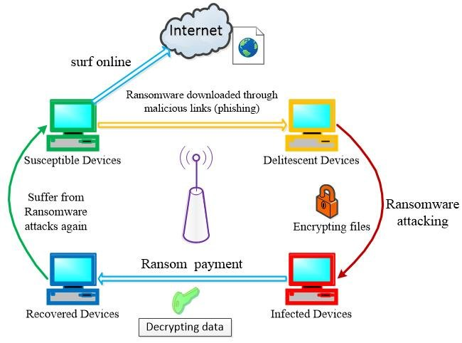
Structure of Attack:

Slide 5
Problem Statement :
Ransomware attacks have become increasingly prevalent and devastating, targeting individuals, organizations, and critical infrastructure.
These attacks encrypt sensitive data, demanding ransom payments in exchange for decryption keys. The attacker then demands a ransom, usually in cryptocurrency, in exchange for the decryption key or for restoring access to the system.
The consequences include:
Financial losses
Data breaches
System downtime
Reputation damage
Potential national security threats

Slide 6
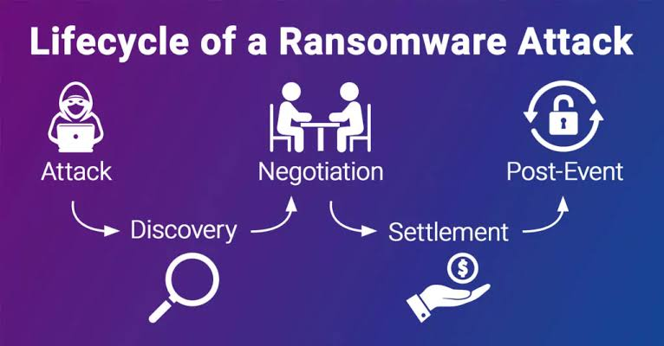

Slide 7
Proposed solution
Develop a Python-based tool to detect and hunt ransomware threats in real-time.
Methodologies used:
Data Collection: Collect samples of known ransomware families and analyze their behavior, API calls, and network traffic.
Feature Engineering: Extract relevant features from the collected data, such as API call sequences, network traffic patterns, and file system interactions.
Machine Learning: Train a machine learning model using the extracted features to classify malware as ransomware or .
Real-time Detection: Implement a real-time detection system that monitors system activity and network traffic for signs of ransomware.
Alerting and Reporting: Generate alerts and reports when ransomware is detected, including detailed information about the attack.
Continuous Improvement: Continuously update the tool with new ransomware samples and improve the machine learning model's accuracy.

Slide 8
Why Python?
Python, with its simplicity and extensive libraries, is an ideal language for ransomware threat hunting.
Python's robust capabilities allow cybersecurity professionals to automate tasks such as scanning file systems for suspicious patterns, analyzing network traffic for ransomware signatures, and correlating logs to detect anomalies.
Additionally, Python libraries like Scapy, YARA-python, and pandas empower analysts to build custom tools tailored to their specific security requirements.
This guide explores the use of Python for ransomware threat hunting, providing practical insights into detecting and mitigating ransomware threats.
It covers techniques for identifying ransomware behavior, developing detection scripts, and leveraging Python's ecosystem to enhance threat-hunting capabilities. By the end, readers will understand how to use Python as a powerful ally in the fight against ransomware.

Slide 9
Technologies Used:
Machine Learning (ML): Train models to recognize ransomware patterns.
Deep Learning (DL): Utilize Convolutional Neural Networks (CNNs) for image-based detection.
Natural Language Processing (NLP): Analyze ransomware notes and communication.
File Analysis: Examine file attributes, entropy, and signatures.
System Monitoring: Track system calls, API interactions, and network activity.
Behavioral Analysis: Monitor process behavior and system changes.

Slide 10
Key Components
To develop a comprehensive ransomware threat-hunting solution using Python, the system requires several key components. These components work together to detect, analyze, and respond to ransomware activities effectively.
Data Collection:
File System Monitoring:
Monitors directories and files for suspicious activities such as rapid encryption, renaming, or deletion.
Tools: Python libraries like os, watchdog, and pyinotify.
Network Traffic Capture:
Collects and analyzes incoming and outgoing traffic to identify anomalies such as connections to known malicious IPs or unusual data exfiltration.
Tools: Libraries like Scapy and external tools like Wireshark (integrated with Python).

Slide 11
2. Data Analysis and Processing
IoC Matching:
Scans collected data for known IoC’s, such as malicious hashes, domains, and IPs.
Tools: Libraries like hashlib for checksum validation and YARA-python for pattern matching.
Anomaly Detection:
Identifies unusual patterns in system and network behavior.
Tools: Python libraries like pandas, numpy, and statsmodels for statistical analysis.
Heuristic and Behavioral Analysis:
Detects behaviors consistent with ransomware, such as mass file encryption or unexpected process launches.
Tools: psutil for process monitoring and subprocess for system command analysis.

Slide 12
2. Data Analysis and Processing
IoC Matching:
Scans collected data for known IoCs, such as malicious hashes, domains, and IPs.
Tools: Libraries like hashlib for checksum validation and YARA-python for pattern matching.
Anomaly Detection:
Identifies unusual patterns in system and network behavior.
Tools: Python libraries like pandas, numpy, and statsmodels for statistical analysis.
Heuristic and Behavioral Analysis:
Detects behaviors consistent with ransomware, such as mass file encryption or unexpected process launches.
Tools: psutil for process monitoring and subprocess for system command analysis.

Slide 13
3. Detection and Threat Identification:
Rule-based Detection Engine:
Defines rules for detecting ransomware activities (e.g., high-frequency file modifications, abnormal CPU/disk usage).
Tools: Libraries like YARA-python.
Pattern Recognition:
Matches network or file behaviors to known ransomware activity patterns.
Tools: regex and networkx (for graph-based pattern recognition).
4. Response and Mitigation:
Firewall and Network Controls:
Blocks malicious IPs or domains using APIs for firewalls or network security tools.
Tools: Python libraries for interacting with firewalls, such as paramiko for SSH-based configurations.
Incident Reporting:
Generates reports detailing the threat, actions taken, and recommendations.
Tools: Libraries like reportlab or Jinja2 for report generation.

Slide 14
5. Visualization and Reporting:
Dashboards:
Displays ransomware activity, detection metrics, and threat-hunting insights.
Tools: Libraries like Plotly, Dash, or matplotlib.
Trend Analysis:
Visualizes historical data to identify recurring ransomware patterns.
Tools: Libraries like seaborn or bokeh.
6. Integration with Security Ecosystem:
SIEM Integration:
Connects with tools like Splunk, Elasticsearch, or Graylog for centralized log management and analysis.
Tools: REST APIs or Python client libraries for SIEM platforms.
Threat Intelligence Feeds:
Fetches IoC’s in real time to stay updated on emerging threats.
Tools: APIs from platforms like Virus Total or MISP.

Slide 15
Working procedure
Step 1:
Set Up the Environment Before starting the threat-hunting process, ensure that the environment is properly set up.
This includes installing the necessary libraries and setting up the required tools.
Install Required Python Libraries: These libraries will help with various tasks like file system monitoring, network traffic analysis, and log parsing.
Ensure Access to Necessary Data File System: Ensure Python can access file directories and files.
Network Traffic: Access to network monitoring tools or interfaces for packet sniffing.
Logs: Access to security logs (e.g., firewall logs, IDS/IPS logs, system logs).

Slide 16
Step 2:
File System Monitoring: Monitoring the file system for suspicious activity, such as ransomware creating or modifying files, is crucial.
Monitor File System for Suspicious File
Extensions : Ransomware often creates encrypted files with specific extensions (e.g., .encrypted, .lock, .enc).
Use Python's watchdog or OS libraries to monitor file creation, modification, or deletion.
Step 3:
Network Traffic Analysis Ransomware may communicate with external servers to encrypt files, receive commands, or exfiltrate data.
You can use Python to capture and analyze network traffic for such signs.
Capture Network Traffic : Use Scapy to sniff network packets and identify unusual or suspicious IP addresses.
Python Look for Suspicious Network Patterns: Look for large outbound data transfers or connections to suspicious IP’s. Check if packets are being sent to known malicious IP addresses using threat intelligence feeds.

Slide 17
Step 4:
Log Analysis System logs can provide valuable insight into ransomware activities, such as unusual login attempts, file accesses, and network connections.
Parse System Logs : Parse logs from IDS/IPS, firewalls, or system logs to look for anomalies that may indicate ransomware behavior.
Python Search for Suspicious Activities :Look for failed login attempts, large file movements, or new processes being executed at odd times.
Step 5:
Behavioral Analysis and Ransomware Indicators Ransomware often exhibits certain behaviors such as mass file encryption or the creation of ransom notes. You can use Python to detect these behaviors .
Detect Ransomware File Encryption : Ransomware often encrypts many files quickly. You can monitor the number of files modified or created in a short period.
Track the creation of ransom notes (.txt, .html,.png files) that contain ransom demands.

Slide 18
Step 6:
Malware Detection with YARA Rules .YARA is a tool that can be used to scan files for malware signatures.
You can create or use pre-defined YARA rules to detect ransomware.
Create or Use YARA Rules :Write YARA rules to detect ransomware-specific patterns, such as file names, encryption algorithms, or ransom notes .
Scan Files Using YARA : Use Python to automate YARA scanning across files.
Step 7:
Alerting and Automated Response If suspicious activity is detected, it is important to send alerts to administrators or trigger automated responses (e.g., blocking IP addresses, quarantining files).
Send Alerts : Use Python's smtp lib to send email alerts about suspicious activities.
Python Automate Response : Automate responses like blocking suspicious IPs or quarantining files using Python .

Slide 19
Step8:
Continuous Monitoring and Reporting To be proactive, threat hunting should be an ongoing process.
Automate continuous scanning and generate detailed reports for each detection event.
Set Up Continuous Monitoring : Use a task scheduler (eg.cron job on Linux or Task Scheduler on Windows) to run Python scripts at regular intervals.
Generate Reports : Use Python to generate reports on detected ransomware activities, which can be saved in CSV or PDF formats for further analysis

Slide 20
Reference :
How Ransomware Attacks, 2021, [online] Available: https://www.sophos.com/en-us/medialibrary/PDFs/technical-papers/sophoslabs-ransomware-behavior-report.pdf.
"Ransomware: Defending Against Digital Extortion" by Allan Liska and Timothy Gallo
"Threat Hunting: A Guide to Threat Hunting and Incident Response" by Fernando Martinez and Ryan Chapman
"Cybersecurity Threats: A Guide to Understanding and Mitigating Threats" by Mark Stanislav
Sharmeen , Y. A. Ahmed, S. Huda, B. S. Kocer and M. M. Hassan, "Avoiding future digital extortion through robust protection against ransomware threats using deep learning based adaptive approaches", IEEE Access, vol. 8, pp. 24522-24534, 2020

Slide 21
Conclusion :
Ransomware has emerged as one of the most significant and evolving cybersecurity threats facing organizations and individuals in the digital age.
This paper has provided a comprehensive analysis of current trends in ransomware attacks, examined detection and mitigation strategies, and explored future predictions and research directions.

Slide 22
Future Scope :
The future scope of ransomware threat hunting will likely focus heavily on utilizing advanced AI and machine learning techniques to proactively identify suspicious activity across networks, detect early signs of ransomware attacks through behavioral analysis, and rapidly respond to potential threats by leveraging automated tools and threat intelligence, especially as ransomware actors become more sophisticated in their methods.

Slide 23
Thank You

